Slide 1
LAB – 10
Arrays and pointers

Slide 2
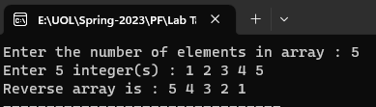
Task - 1
Write a C++ program that reverse the elements of an integer array.

Slide 3
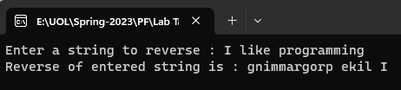
Task - 2
Write a C++ program that prints string in reverse order.

Slide 4
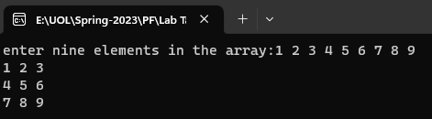
Task - 3
Write a C++ program to input nine elements in a two dimensional array and print it.

Slide 5
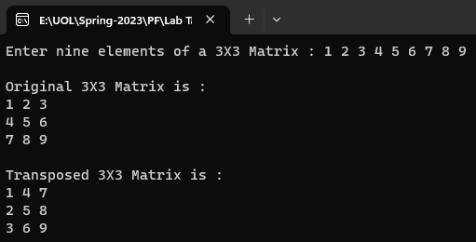
Task - 4
Write a C++ program to input a matrix and print its transpose.

Slide 6
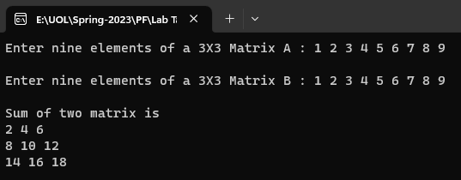
Task - 5
Write a program that will add two matrixes entered by the user and print it.

Slide 7
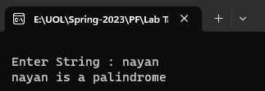
Task - 6
Write a C++ program to check whether the entered string is palindrome or not.

